Slide 1
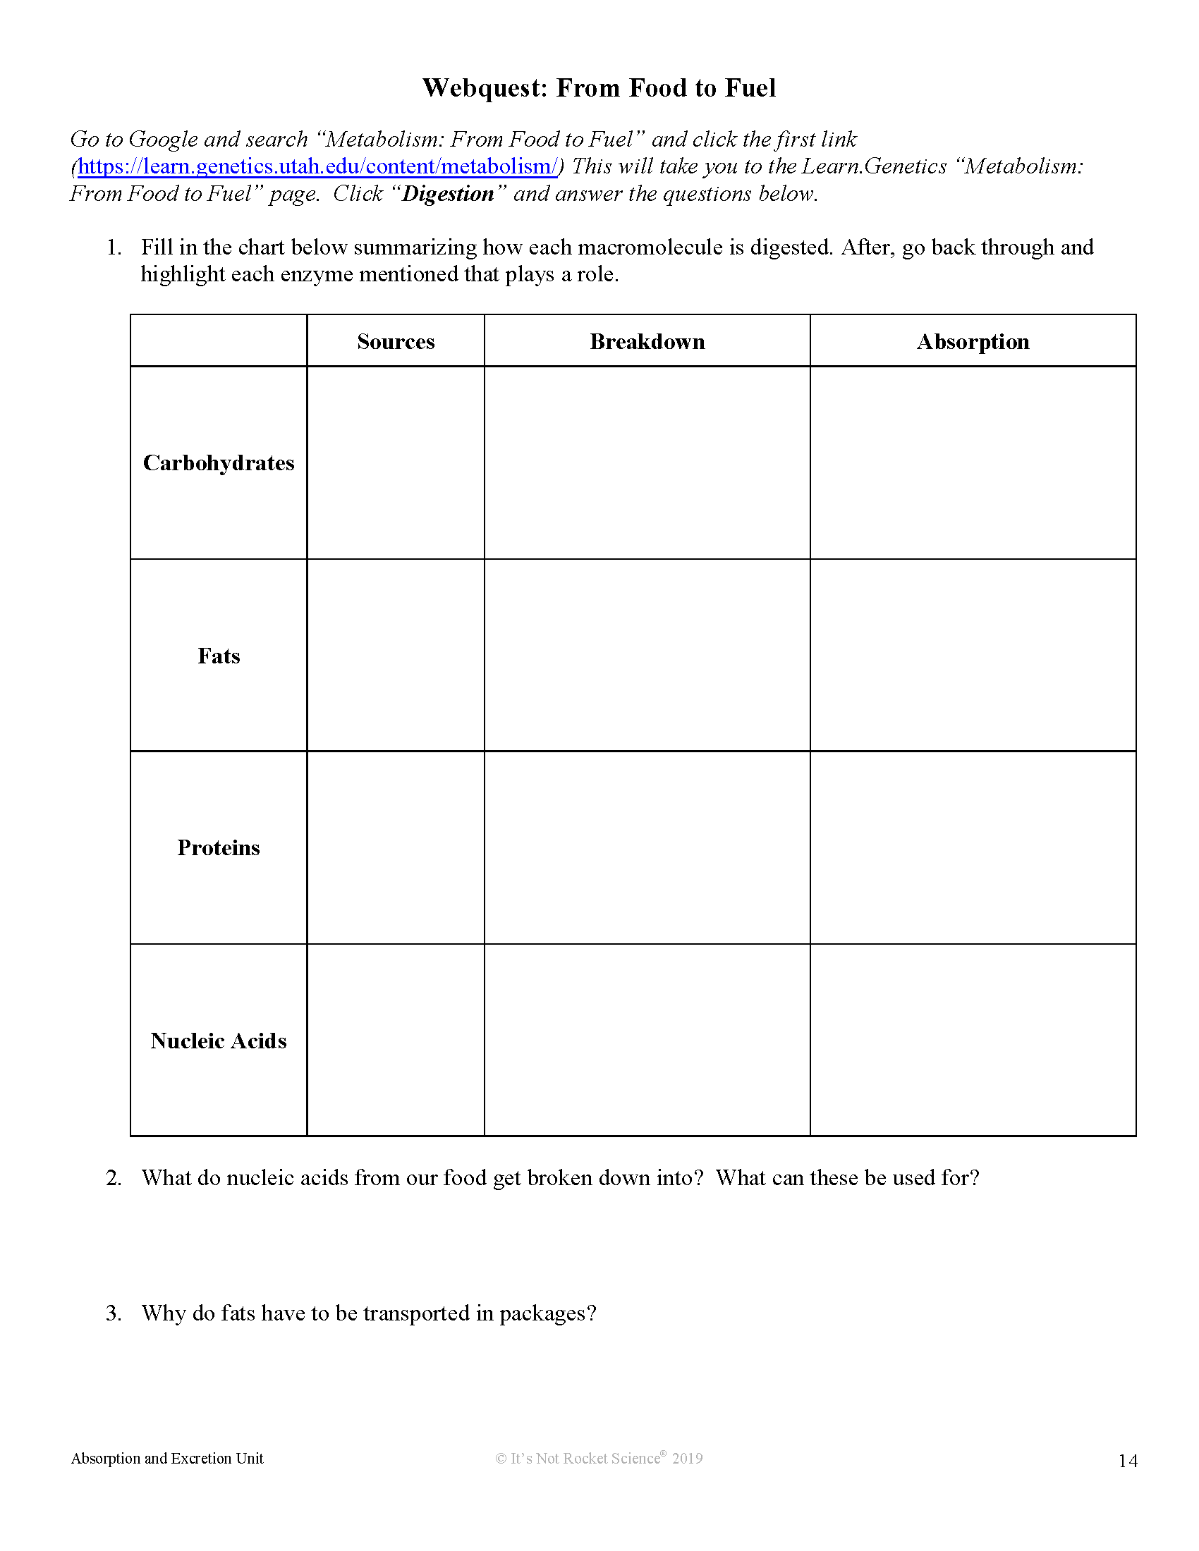
Add Text Here!
Add Text Here!
Add Text Here!
Add Text Here!
Add Text Here!
Add Text Here!
Add Text Here!
Add Text Here!
Add Text Here!
Add Text Here!
Add Text Here!
Add Text Here!
Add Text Here!

Slide 2
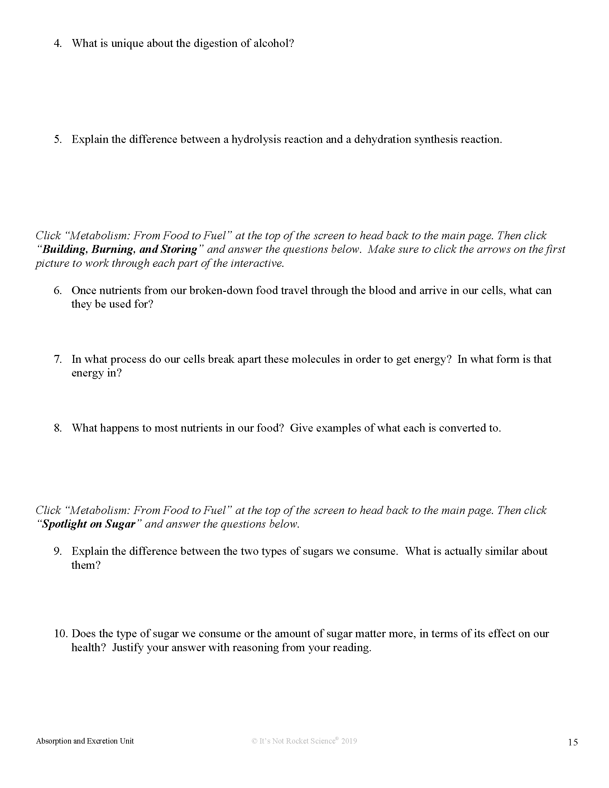
Add Text Here!
Add Text Here!
Add Text Here!
Add Text Here!
Add Text Here!
Add Text Here!

Slide 3
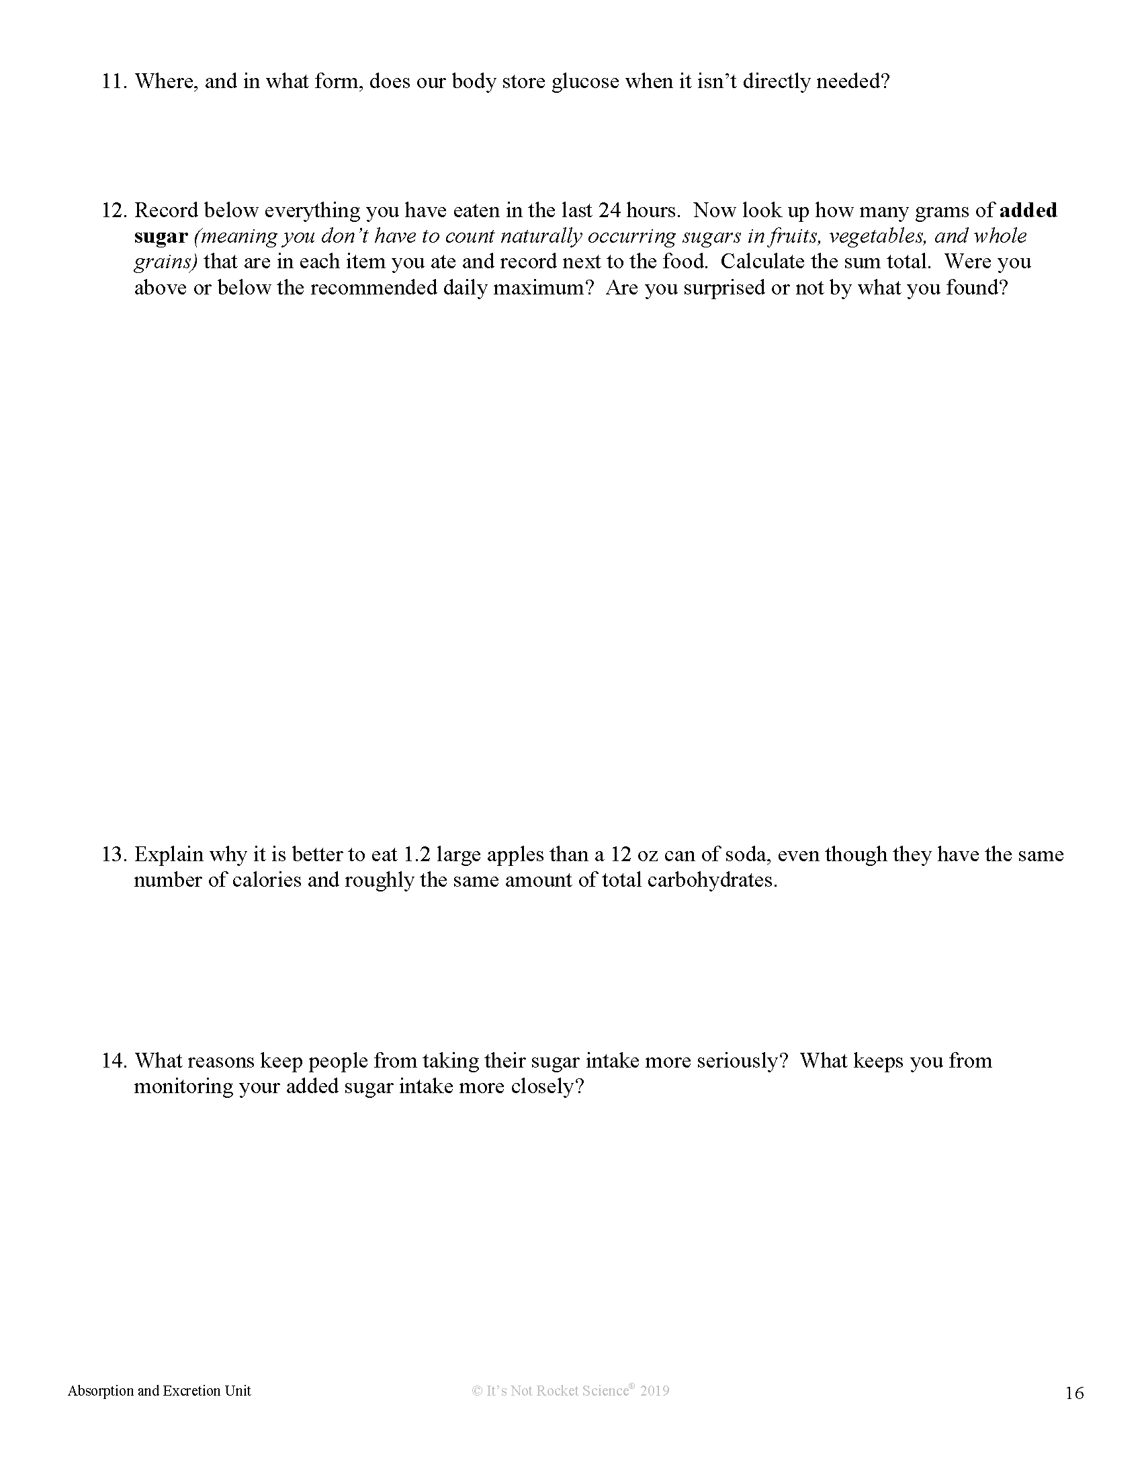
Add Text Here!
Add Text Here!
Add Text Here!
Add Text Here!

Slide 4
Add Text Here!
Add Text Here!
Add Text Here!
Add Text Here!
Add Text Here!
Add Text Here!

